Slide 1

Classification models
Shubhang mittal

Slide 2
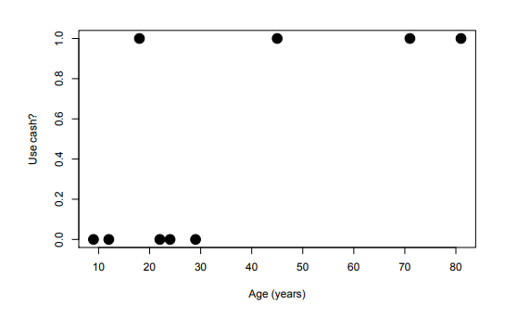
Logistic Regression

Slide 3
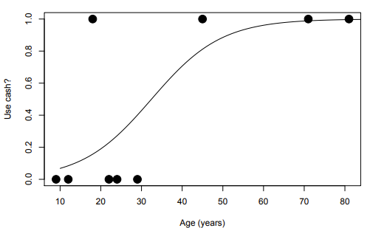
Logistic Regression

Slide 4
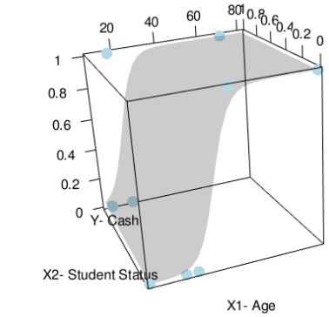
Logistic Regression

Slide 5
Logistic Regression
Standard Linear Regression
Logistic Regression

Slide 6
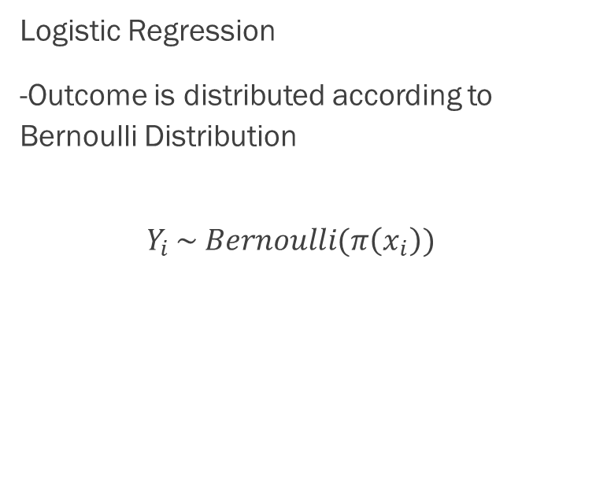

Logistic Regression
Standard Linear Regression
-Assume outcome is normally distributed
$Y_{i } \sim N(x_{i}^{T}β, σ^{2})$
Logistic Regression
-Outcome is distributed according to Bernoulli Distribution
$$Y_{i }\sim Bernoulli(π\left(x_{i}\right))$$

Slide 7
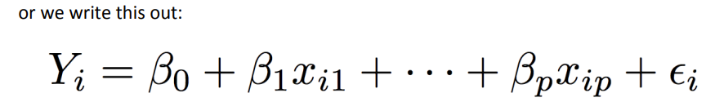
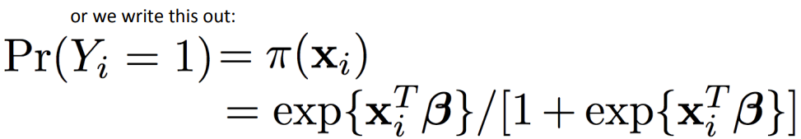


Logistic Regression
Standard Linear Regression
-Assume outcome is normally distributed
$Y_{i} \sim N(x_{i}^{T}β, σ^{2})$
Logistic Regression
-Outcome is distributed according to Bernoulli Distribution
$$Y_{i} \sim Bernoulli(π\left(x_{i}\right))$$

Slide 8
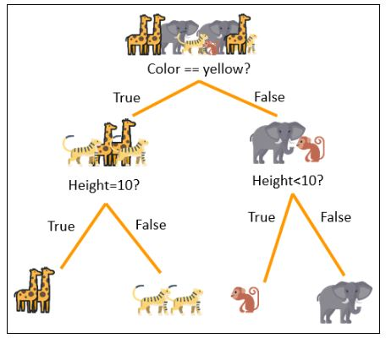
Decision Tree Classification

Slide 9
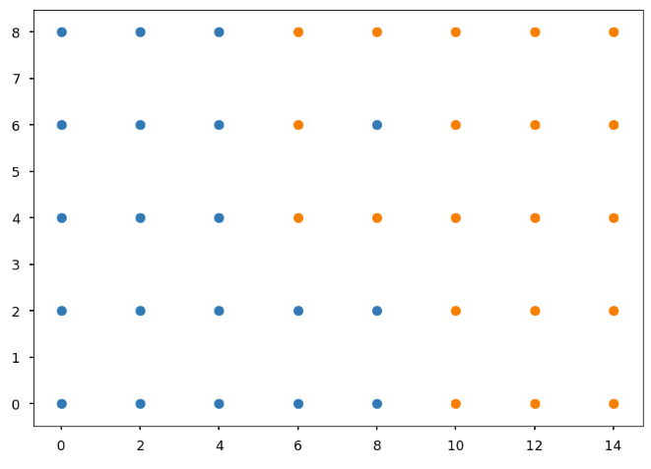
Decision Tree Classification

Slide 10
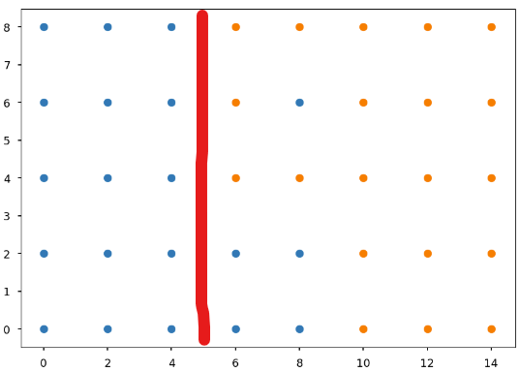
Decision Tree Classification

Slide 11
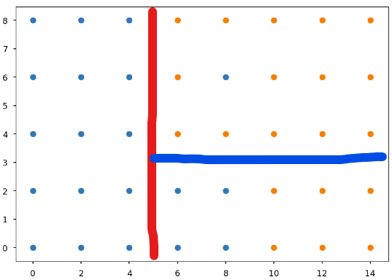
Decision Tree Classification

Slide 12
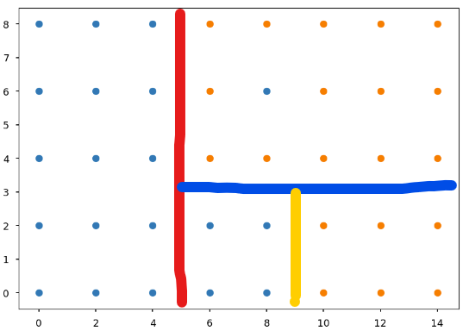
Decision Tree Classification

Slide 13
